Slide 1
Chapter 5: Principles of Detailed Design
Software Architecture and Design

Slide 2
Session’s Agenda
Overview of Detailed Design
  What is detailed design?
  Where does it fit?
Key Tasks in Detailed Design
  Understanding architecture and requirements
  Creating detailed designs
  Evaluating detailed designs
  Documenting detailed designs
  Monitoring and controlling implementation
What’s next…

Slide 3
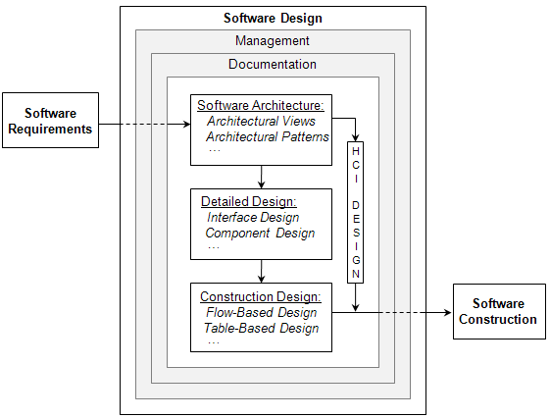
First, Let’s Think About Where We Are…
Important:
At this point, requirements and architecture are specified; they are deemed sufficiently complete to begin the detailed design of the system.
We started here
Eventually, we want to get here!
We are here!
Our design efforts shift from the macro-design approach to a micro-design approach
We now seek to further decompose and refine system components into one or more fine-grained elements, functions, and data variables.

Slide 4
What is Detailed Design?
According to the IEEE [1],
  The process of refining and expanding the preliminary design phase of a system or component to the extent that the design is sufficiently complete to be implemented .
  The result of the process in 1.
To keep terminology consistent, we’ll use the following definition:
  The process of refining and expanding the preliminary design phase software architecture of a system or component to the extent that the design is sufficiently complete to be implemented .
  The result of the process in 1.
During Detailed Design designers go deep into each component to define its internal structure and behavioral capabilities, and the resulting design leads to natural and efficient construction of software.

Slide 5
What is Detailed Design?
Clements et al. [2] differentiate between architectural and detailed design as follows:
  “Architecture is design, but not all design is architecture. That is, many design decisions are left unbound by the architecture and are happily left to the discretion and good judgment of downstream designers and implementers. The architecture establishes constraints on downstream activities, and those activities must produce artifacts—finer-grained design and code—that are compliant with the architecture, but architecture does not define an implementation.”
Detailed design is closely related to architecture and construction; therefore successful designers (during detailed design) are required to have or acquire full understanding of the system’s requirements and architecture.
  They must also be proficient in particular design strategies (e.g., object-oriented), programming languages, and methods and processes for software quality control.
  Just as architecture provides the bridge between requirements and design, detailed design provides the bridge between design and code.

Slide 6
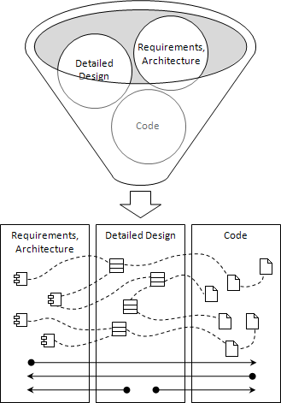
What is Detailed Design?
Designer’s Mental Model During Detailed Design!
Important:
During detailed design, the use of industry-grade development tools are essential for modeling, code generation, compiling generated code, reverse engineering, software configuration management, etc.
Give examples !
If given requirements and architecture, detailed designers must move the project forward all the way to code
If given code, detailed designers must be able to reverse engineer the code to produce detailed and architectural designs.
When starting at detailed design, designers must be able to produce both code and architectural designs

Slide 7
Key Tasks in Detailed Design
In practice, it can be argued that the detailed design phase is where most of the problem-solving activities occur. Consider the case in which a formal process is followed, so that the requirements is followed by architecture and detailed design.
  In many practical applications, the architectural design activity defers complex problem solving to detailed design, mainly through abstraction.
  In some cases, even specifying requirements is deferred to detailed design!
For these reasons, detailed design serves as the gatekeeper for ensuring that the system’s specification and design are sufficiently complete before construction begins.
  This can be especially tough for large-scale systems built from scratch without experience with the development of similar systems.
The major tasks identified for carrying out the detailed design activity include:
  Understanding the architecture and requirements
  Creating detailed designs
  Evaluating detailed designs
  Documenting software design
  Monitoring and controlling implementation

Slide 8


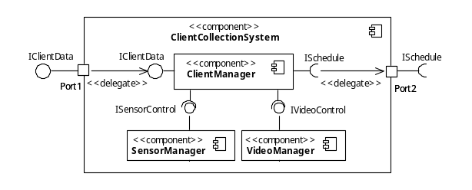



Understanding the Architecture and Requirements
Unlike the software architecture, where the complete set of requirements are evaluated and well understood, designers during detailed design activity focus on requirements allocated to their specific components.
Important:
During detailed design, components are allocated to teams for further design.
Functional and quality requirements allocated to this component
SOFTWARE ARCHITECTURE
DETAILED DESIGN
Detailed
Design
Class
…
IN
During the detailed design of individual components, it is possible for designers to derive requirements and impose them on the implementation of the component.
Functional and quality requirements allocated to this component

Slide 9
Creating Detailed Designs
After the architecture and requirements for assigned components are well understood, the detailed design of software components can begin.
  Detailed design consist of both structural and behavioral designs.
When creating detailed designs, focus is placed on the following:
  Interface Design
    Internal interface design
    External interface design
  Graphical User Interface Design
    This may be a continuation of designs originated during architecture.
  Internal Component Design
    Structural
    Behavioral
  Data Design

Slide 10
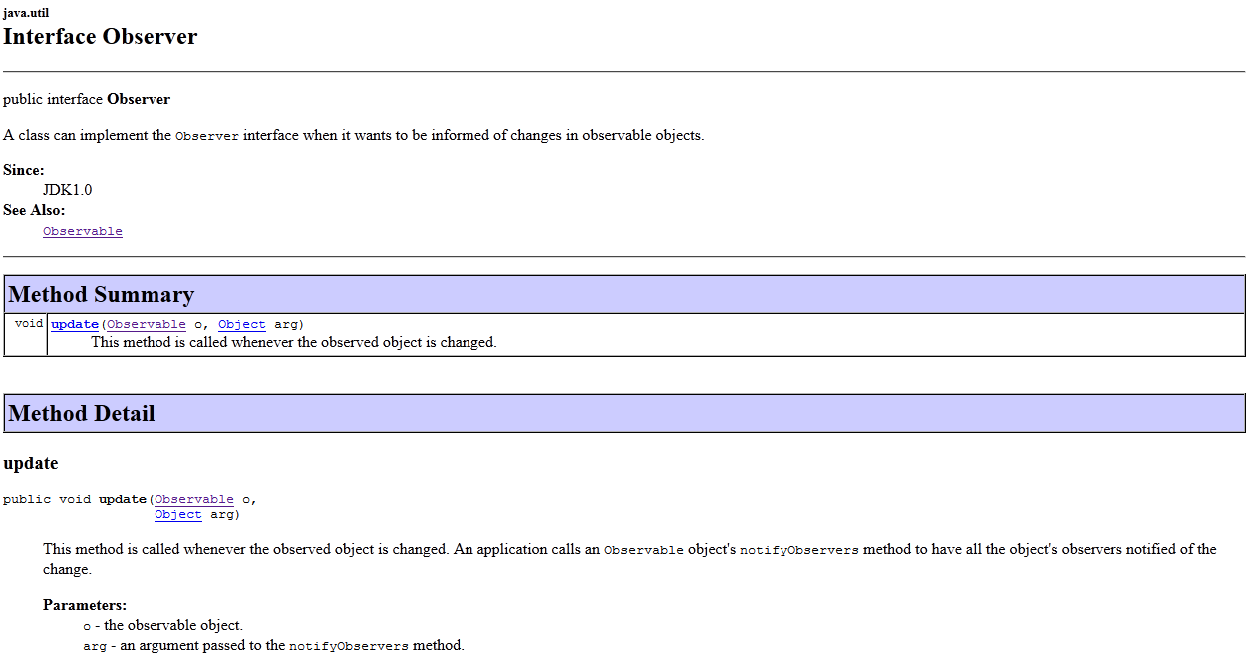
Creating Detailed Designs
Interface Design
  Refers to the design task that deals with specification of interfaces between components in the design [3]. It can be focused on:
    Interfaces internally within components
    Interfaces used externally across components
An example of an internal interface design can be seen below:
Note:
We can model this interface easily with UML.
The Observer interface in Java can be used internally within components to support the Observer design pattern.
The design of this interface specifies a well-defined method.

Slide 11
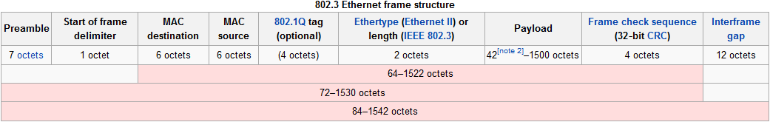
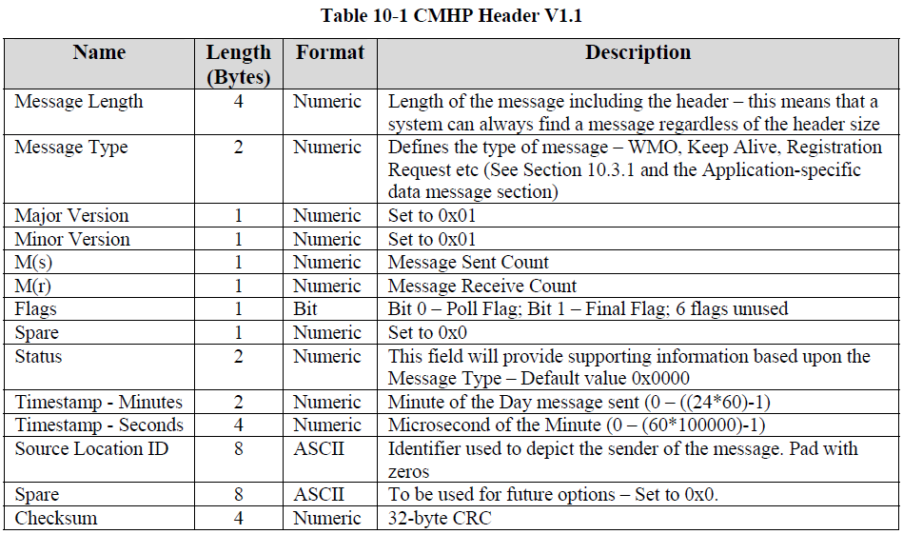
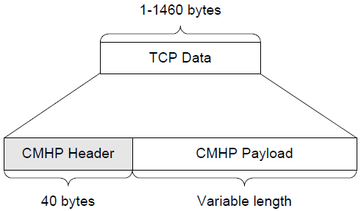
Creating Detailed Designs
Example of external interface design (from Wikipedia)
This is already specified by the 802.3 standard, but, you may design your own application-specific messaging specification at the application level. When you do so, you end up with an Interface Design Document containing all the information about the messaging format. For example, see below
The CMHP Header is designed as seen in the table to the right.
Example extracted from : https://faaco.faa.gov/attachments/5B9EDCCD-D566-F405-67840C21B590D68C.pdf

Slide 12
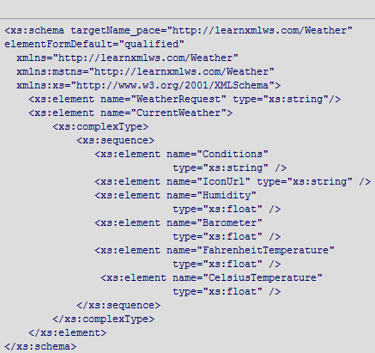
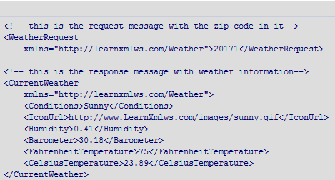
Creating Detailed Designs
Another example of external interface design in XML
Example extracted from link below. For more details of this example, please navigate to the link below
http://msdn.microsoft.com/en-us/magazine/cc188900.aspx#S2

Slide 13
Evaluating Detailed Designs
Logical designs are verified using static techniques; that is, through non-execution of the software application.
  This makes sense since at this point, the software has not been constructed!
The most popular technique for evaluating detailed designs involves Technical Reviews. When conducting technical reviews, keep in mind the following:
  Send a review notice with enough time for others to have appropriate time to thoroughly review the design.
  Include a technical expert in the review team, as well as stakeholders of your design.
  Include a member of the software quality assurance or testing team in the review.
  During the review, focus on the important aspects of your designs; those that show how your design helps meet functional and non-functional requirements.
  Document the review process.
    Make sure that any action items generated during the review are captured and assigned for processing.

Slide 14
Documenting Detailed Designs
Documentation of a project’s software design is mostly captured in the software design document (SDD), also known as software design description. The SDD is used widely throughout the development of the software.
  Used by programmers, testers, maintainers, systems integrators, etc.
Other forms of documentation include:
  Interface Control Document
    Serves as written contract between components of the system software as to how they communicate.
  Version Control Document
    Contains information about what is included in a software release, including different files, scripts and executable. Different versions of the design depend on specific software release.

Slide 15
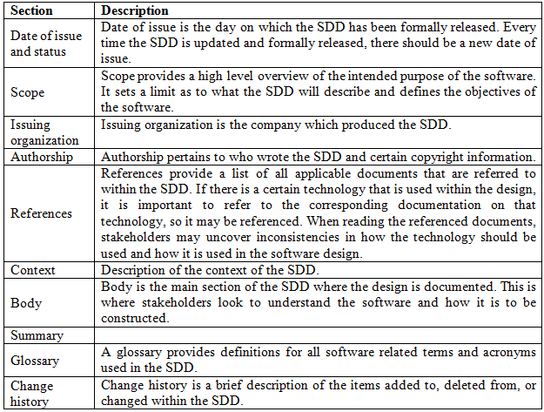
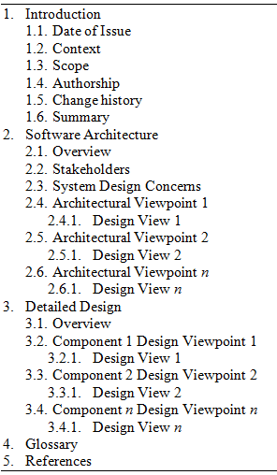
Documenting Detailed Designs
The sections of the SDD and sample table of contents:

Slide 16
Managing Implementation
Detailed design synchronicity is concerned with the degree of how well detailed designs adhere to the software architecture and how well software code adheres to the detailed design.
  Low degree of synchronicity points to a flaw in the process and can lead to software project failure.
Particular attention needs to be paid when projects enter the maintenance phase or when new engineers are brought into the project.
Processes must be in place to ensure that overall synchronicity is high

Slide 17
What’s Next…
In this session, we presented fundamentals concepts of the detailed design activity, including:
  What is detailed design?
  Key tasks in detailed design
In the next session, we will present a more in depth coverage of designing the internal structure of components. This will be necessary to become effective designers, especially when working with design patterns.

Slide 18
References
[1] IEEE. “IEEE Standard Glossary of Software Engineering Terminology.” IEEE, 1990, p.34.
[2] Clements, Paul, Felix Bachmann, Len Bass, David Garlan, James Ivers, Reed Little, Robert Nord, and Judith Stafford. Documenting Software Architectures. Boston, MA: Addison Wesley, 2001.
[3] Sommerville, Ian. Software Engineering, 9th ed. Boston, MA: Addison Wesley, 2010.

